Slide 1
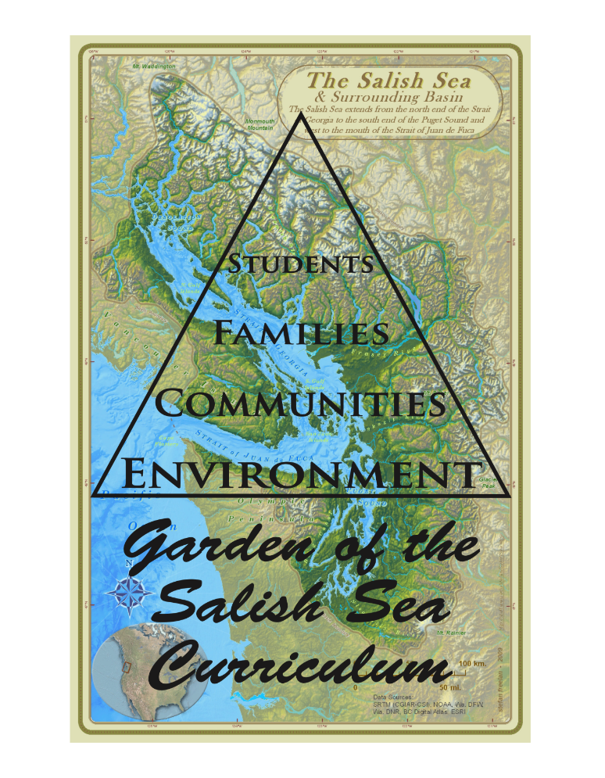


All rights reserved © Garden of the Salish Sea Curriculum 2018

Slide 2
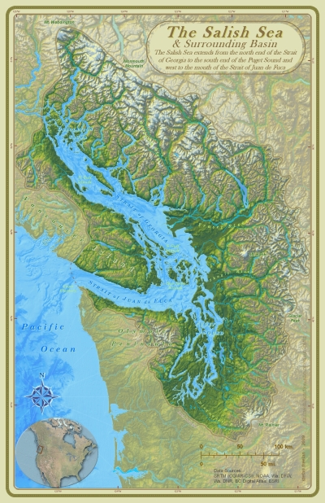
The Salish Sea &
Northwest Straits
Strait of Georgia
Strait of Juan De Fuca
Puget Sound
The Salish Sea Basin covers 7000 square miles
Notes:
Ask students what is this map of?

Slide 3
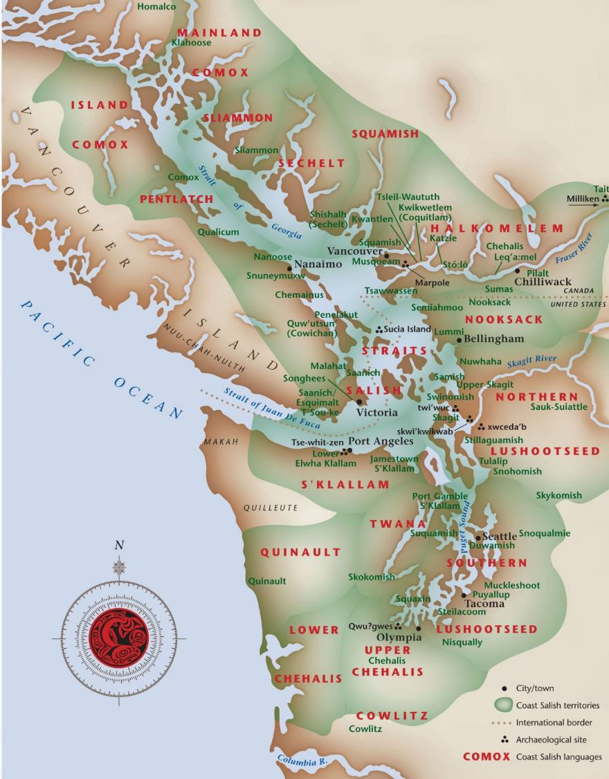
Coast Salish Peoples Map

Slide 4


Shellfish live around the world
and in the Salish Sea!
Shared Waters:Boundary Bay is a Trans-Boundary Waterbody.

Slide 5
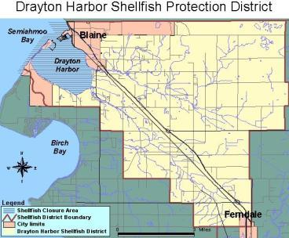

Slide 6
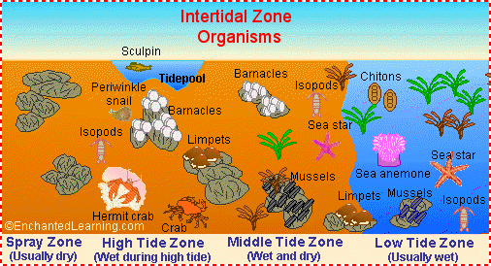

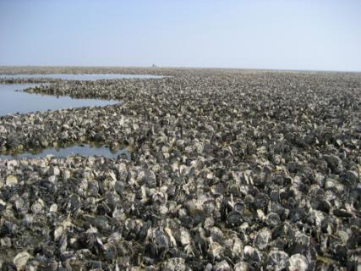
Oysters live in the intertidal zone and create oyster reefs
Oysters are reef builders where communities of other organisms grow. This one’s in Germany

Slide 7
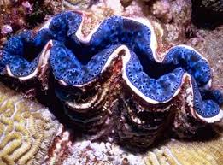
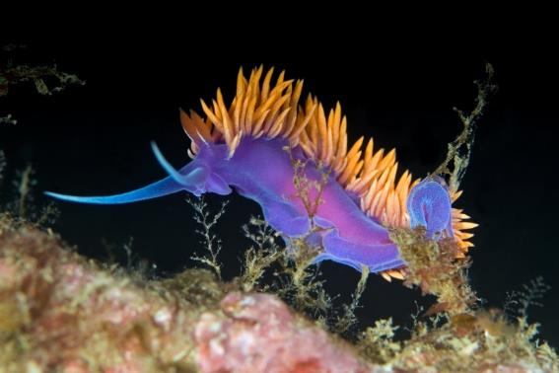
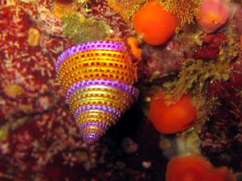
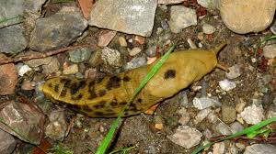
Shellfish are Mollusks
Do they have backbones?
Giant Clam
Spanish Shawl Nudibranch
Purple-Ringed Top Snail
Banana Slug
Photo Credits: www.barrierreefaustralia.com,www.divebums.com, www.tixchamy91.blog.com
Notes:
Shellfish are invertebrates, unlike us because we have a spine therefore are vertebrates

Slide 8
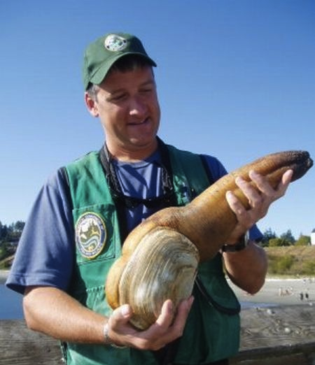
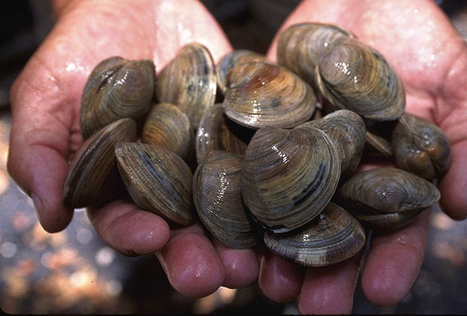
Manila clams were introduced to the Salish Sea from Japan
Geoduck is the largest burrowing clam, can reach up to 8 pounds and live 150 years.

Slide 9
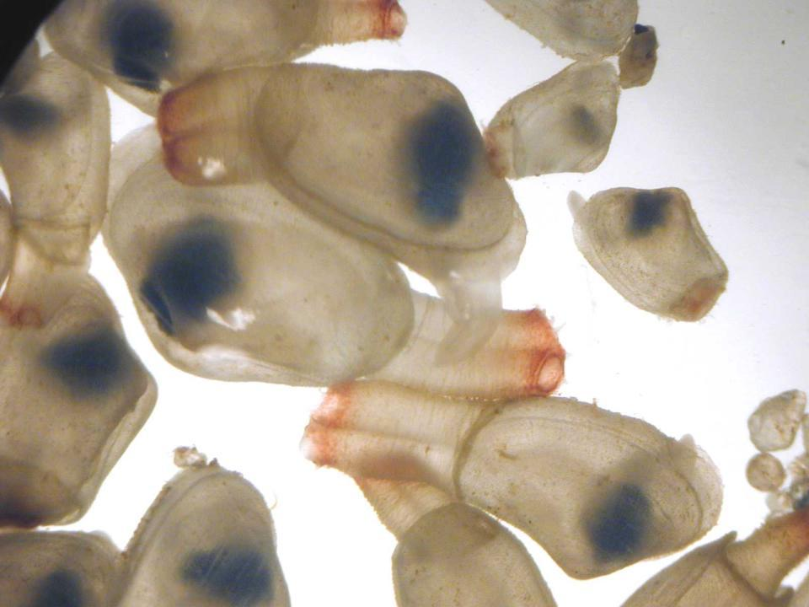

Slide 10
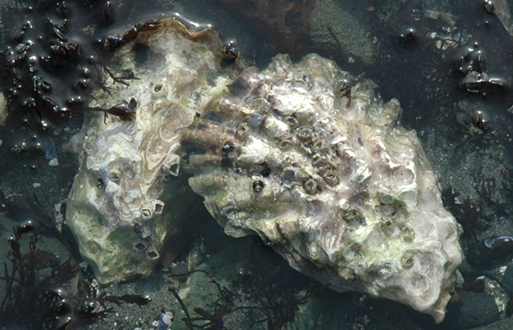
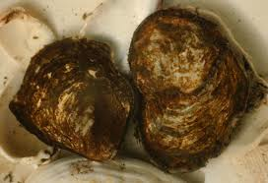
Pacific Oyster (Crassostrea gigas)
Introduced from Japan
Olympia Oyster
(Ostrea lurida)
Only native oyster to the Puget Sound and its populations are threatened

Slide 11
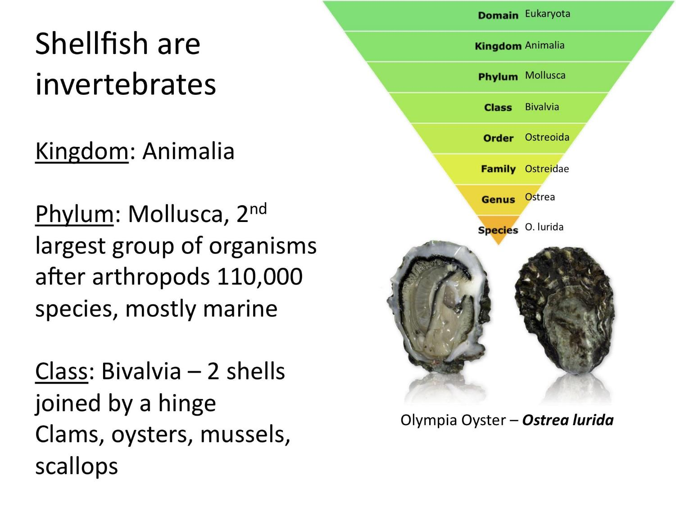
Classification

Slide 12
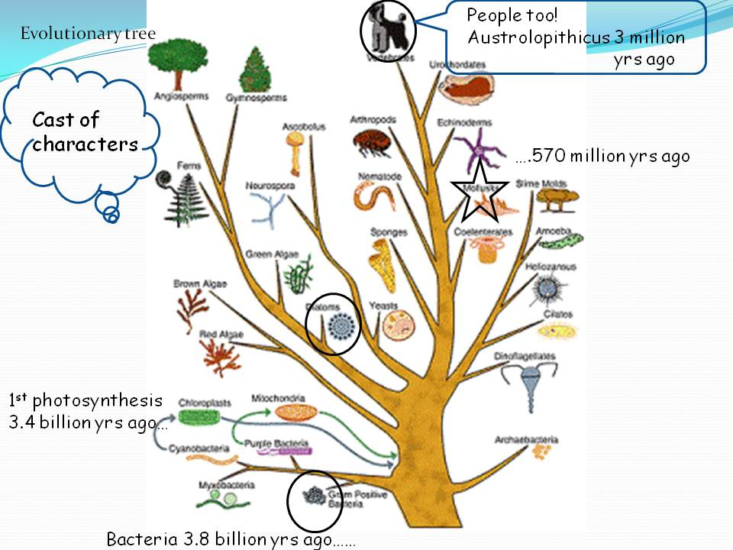

Slide 13
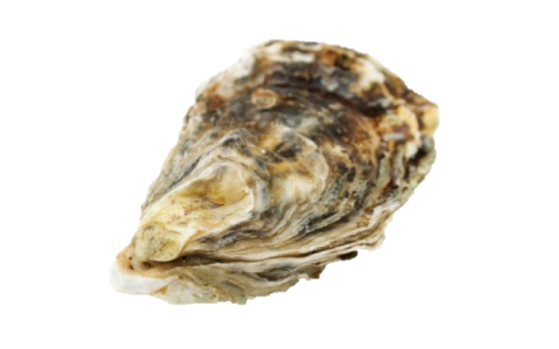
Why are Shellfish Important?
They keep the water clean
They provide habitat
They tell us about the past
They are economically important
They are nutritious… If…
If we keep the water clean!

Slide 14
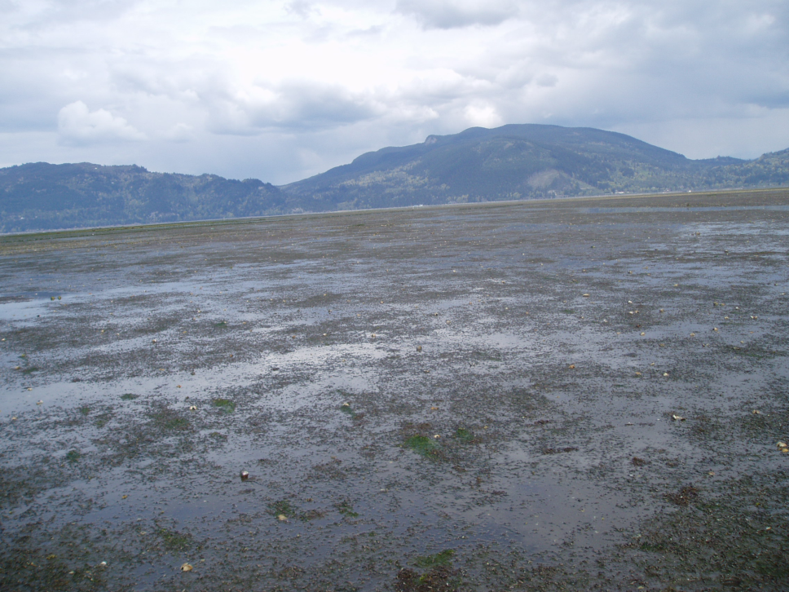
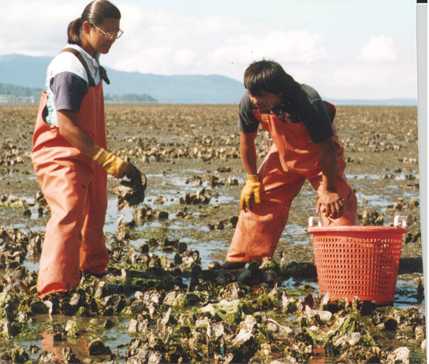
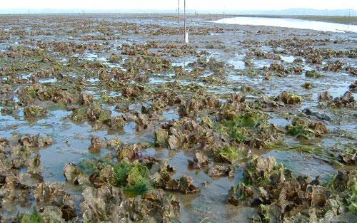
INTERTIDAL OYSTER CULTURE
Traditional on bottom culture
Typical intertidal oyster ground

Slide 15
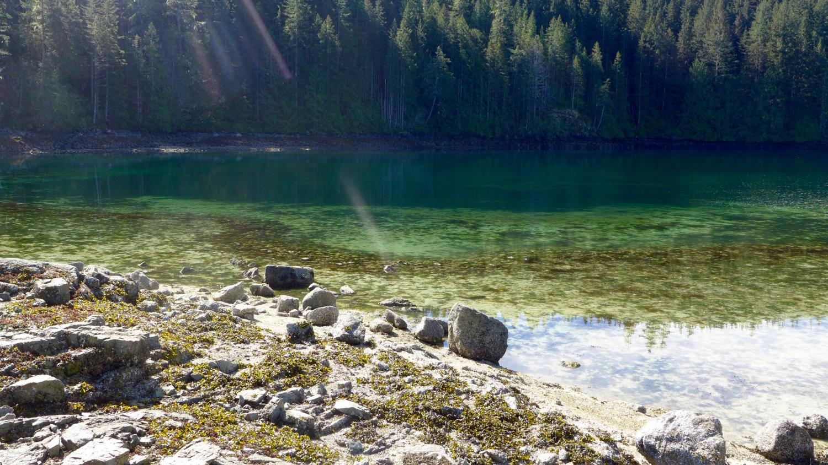
Octopus Islands Provincial Park B.C. – Comox First Nations Traditional Grounds

Slide 16
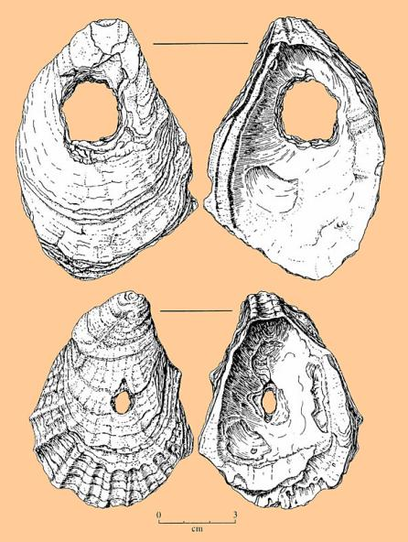
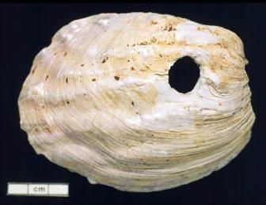
Coast Salish Culture
Shellfish are an important part of Native-American culture. Coast Salish people have harvested shellfish historically for food, used shells for tools and in ceremony for thousands of years.
Hoe blade
Fishing net weights

Slide 17
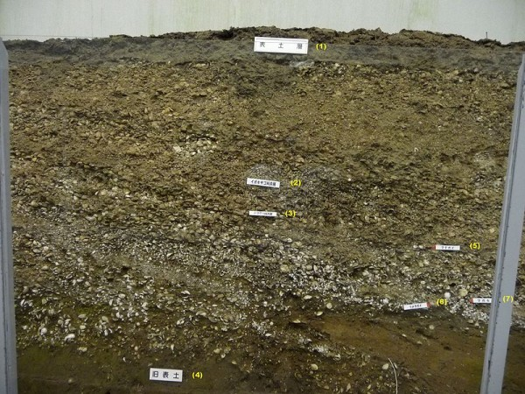
Shellfish tell us about the history of people:
Shellfish Middens are left over shells from people who ate shellfish and disposed of the shells in a pile.
Photo Credit: Public Domain

Slide 18
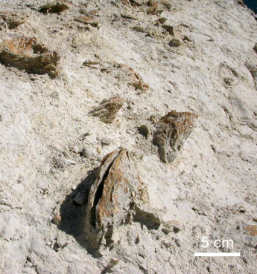
Shellfish tell us about history of the land:
Fossils are the remains of buried prehistoric organisms such as shellfish. They record the history of life from about 3.5 billion years ago.
Hey, that’s the study of paleontology
Photo credit: www.earthhistory.org

Slide 19
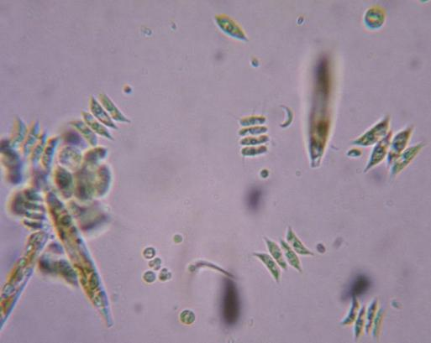
Shellfish play an important role in the food web
They eat phytoplankton
Notes:
Plankton is Greek for drifter – phyto =plants, zoo = animals

Slide 20
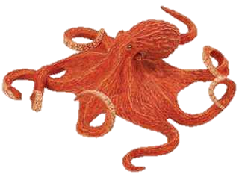
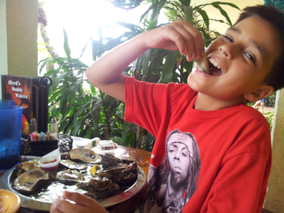
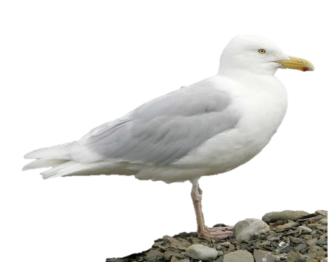
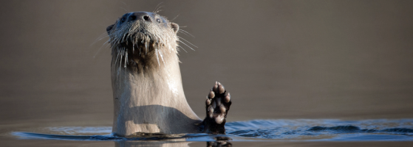
Shellfish are a source of food for other animals
Notes:
Ask students what they think might eat an oyster or clam

Slide 21
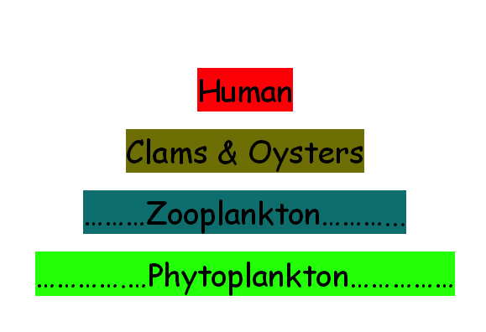
Shellfish Food Chain:
Notes:
Ask students who has heard of a food web or food chain.

Slide 22
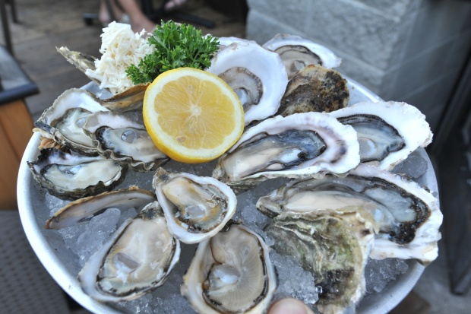
Shellfish are Nutritious and Delicious!
High in Protein
Low in fat
Omega -3 fatty acids
“Brain Food”
Minerals such as iron and zinc to support healthy blood and immune system
*Some people are allergic to shellfish and should not consume any food containing even a small amount

Slide 23
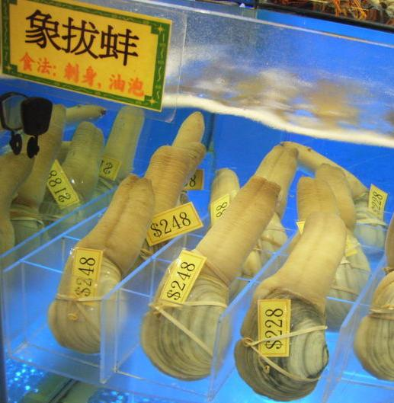
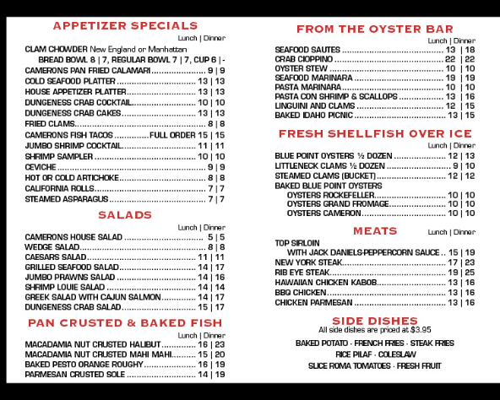
Shellfish in the Pacific Northwest provide an estimated $207 million each year in ecosystem services as well as sales and provides over 3,200 jobs. (NOAA 2012)
PACIFIC COAST SHELLFISH PRODUCTION
WA Shellfish Revenue → $ 100,560,000 All PNW Shellfish Revenue → $ 117,430,000

Slide 24
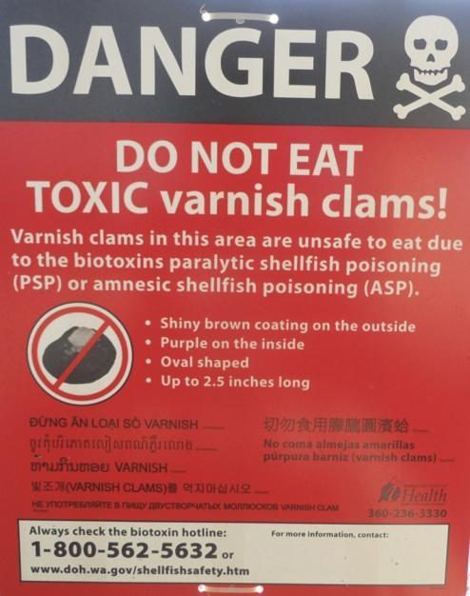
Never eat shellfish you harvested unless you know its safe!

Slide 25
Up Next:
8 minutes per station
Bring your Science Notebooks
Stations include:
Watershed model
Salish Sea Stewards
Live tank
Life cycle
Shellfish in time & place

Slide 26
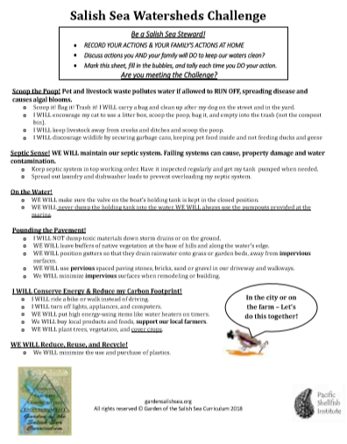
As stewards of the Salish Sea, we can keep this water healthy which will keep us healthy!

Slide 27
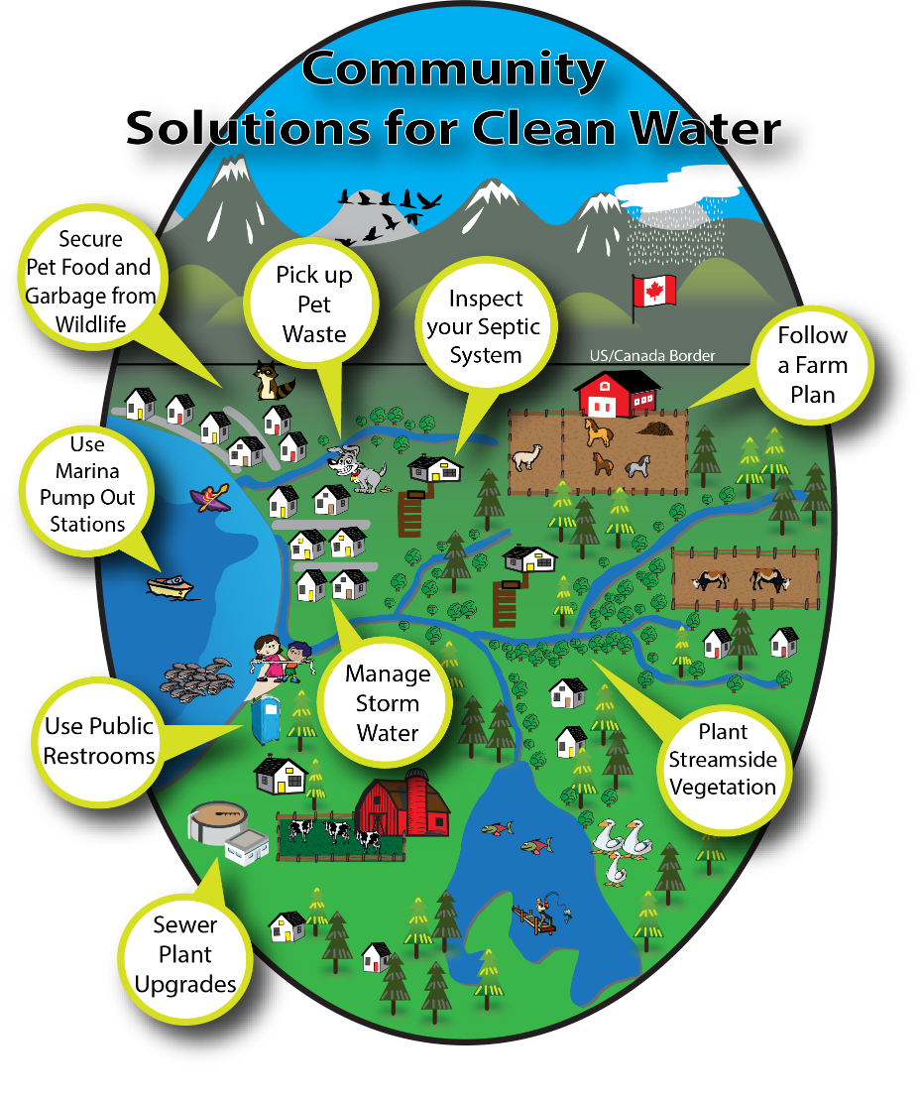

Slide 28
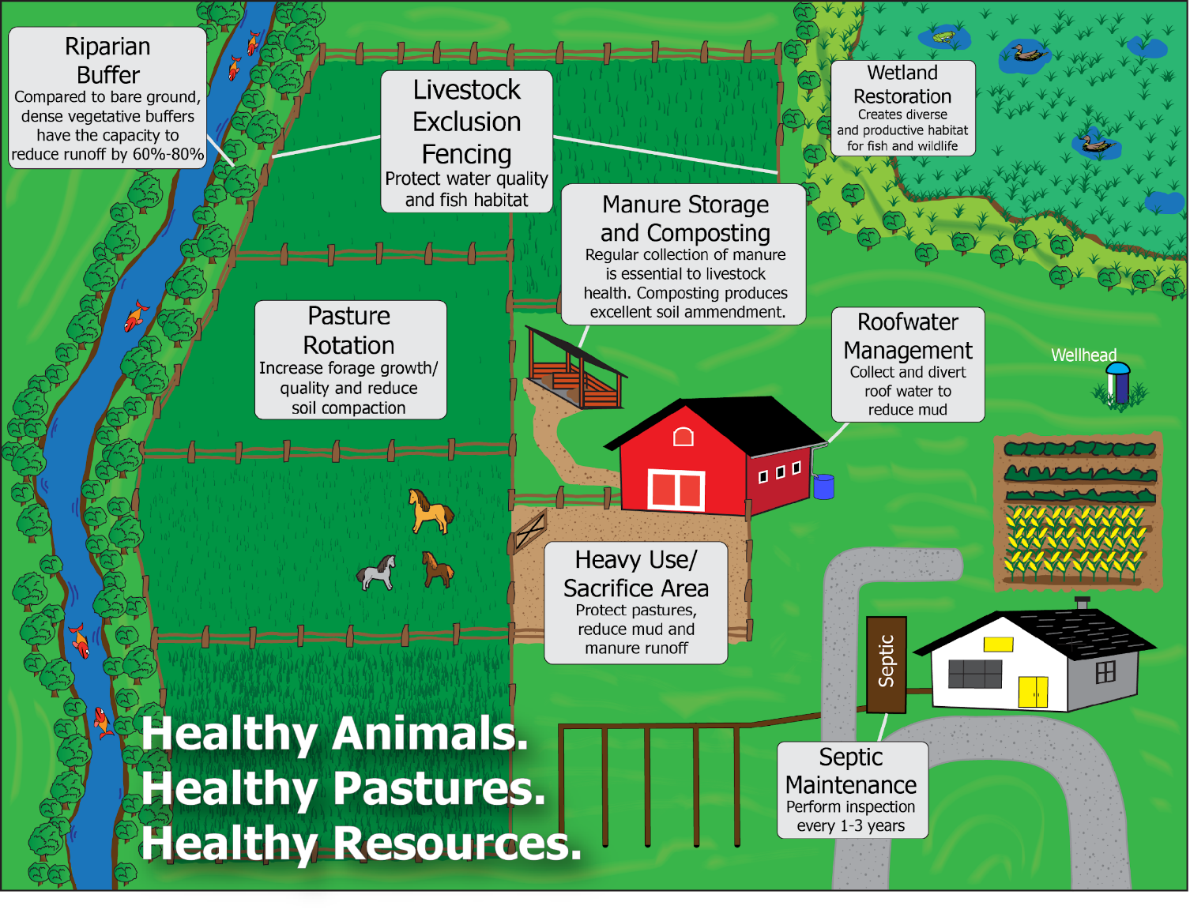

Slide 29


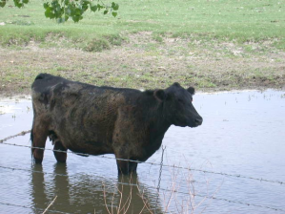

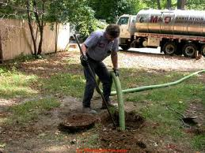
Bacteria from humans and their pets’ poop is getting into the water…
There can be 23 million bacteria per gram of pet waste

Slide 30
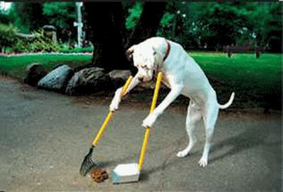
We can scoop the poop!
Photo Credit: www.realclearscience.com

Slide 31



Carbon dioxide is making the ocean more acidic…
All this CO₂ in the water is making my shell thin!

Slide 32
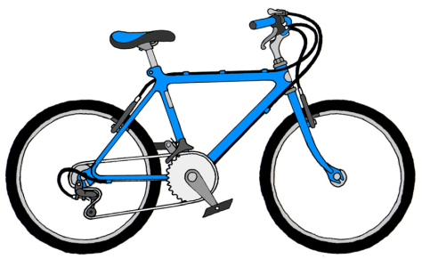

We can reduce our carbon dioxide emissions
1 mile driven in a car = about 1 pound of CO₂
My shell is nice and thick!
Notes:
We can ride a bike to school, carpool, take a bus, or walk to reduce transportation emissions

Slide 33
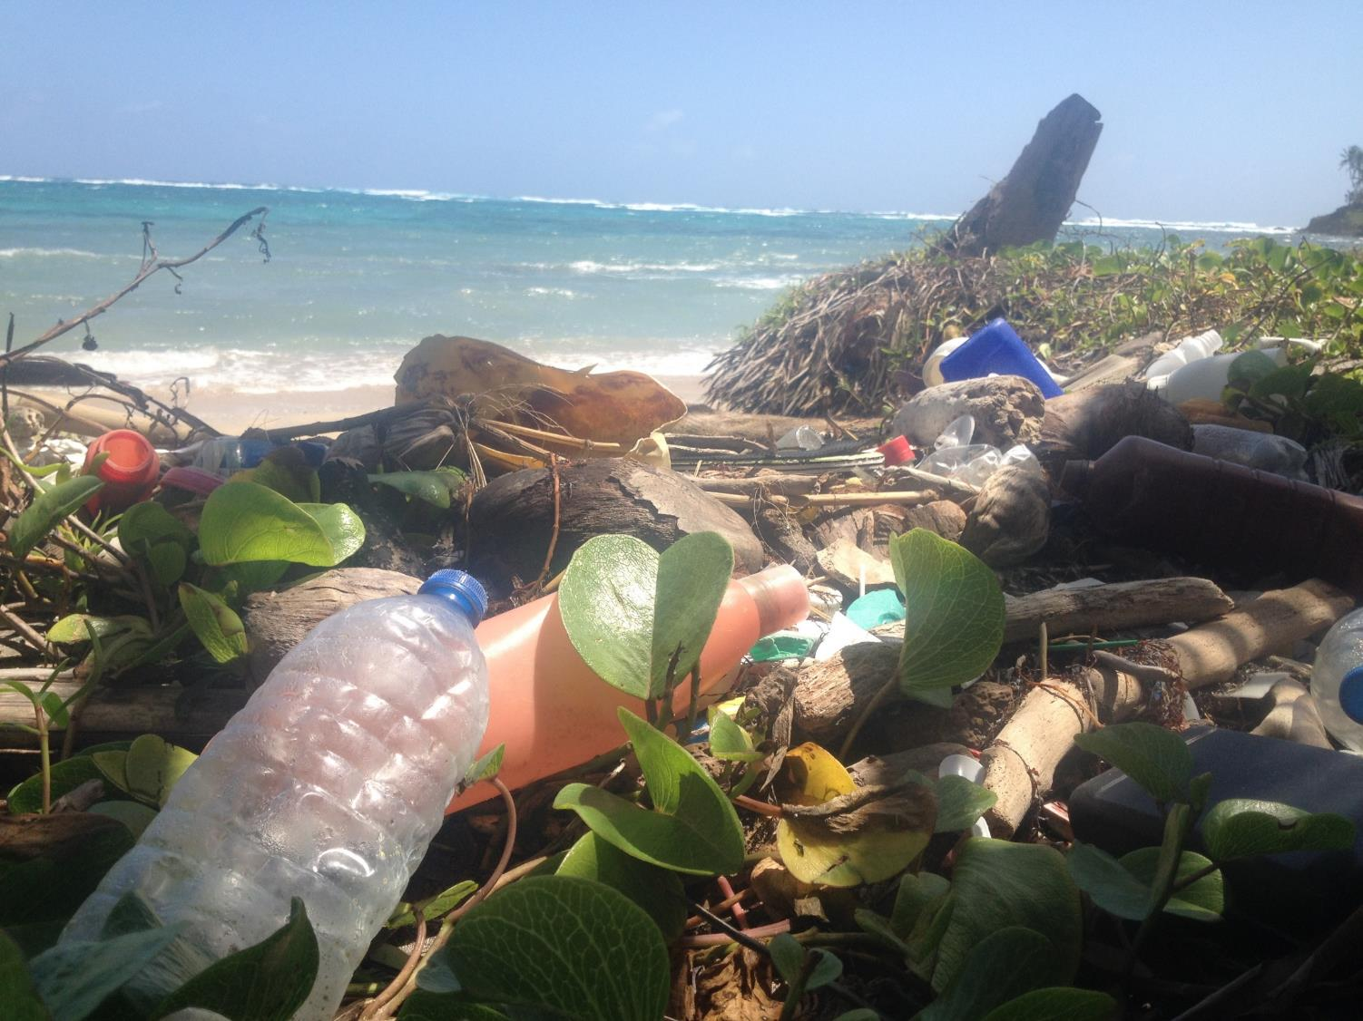
Minimize Plastics – REDUCE-reuse-recycle

Slide 34
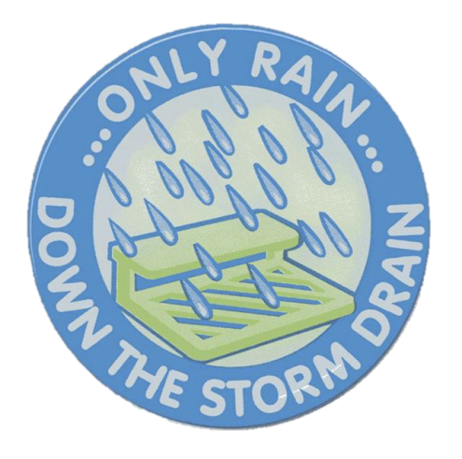
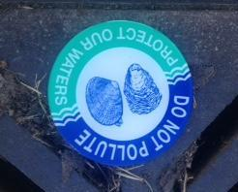
But as Salish Sea Stewards, we can help keep our sea healthy and clean!

Slide 35



All rights reserved © Garden of the Salish Sea Curriculum 2018

