Slide 1
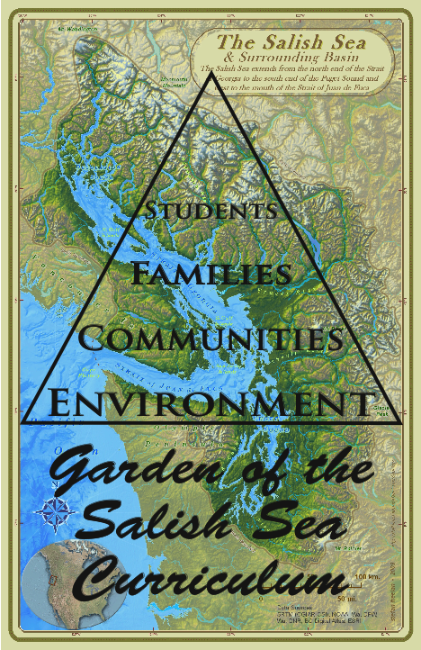


Lummi Island, Beach Elementary 2018
Garden of the Salish Sea
Curriculum
Notes:
Introduction to the name of the curriculum, Who you are, and how this presentation will answer many questions students might have. Ask students to hold questions they might have for the end of the presentation, but I might have questions for the students and will be looking for students with quietly raised hands to answer my questions.

Slide 2
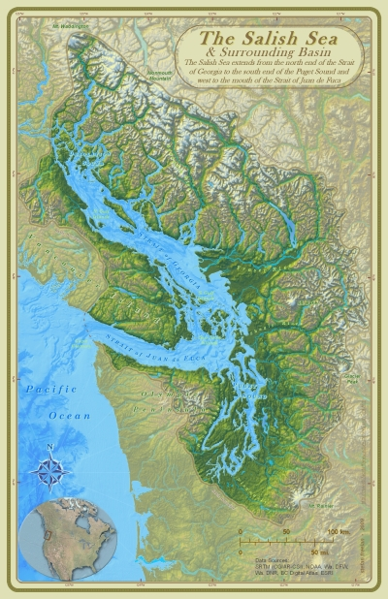
The Salish Sea &
Northwest Straits
Strait of Georgia
Strait of Juan De Fuca
Puget Sound
The Salish Sea Basin covers 7000 square miles
Notes:
Ask students what is this map of?

Slide 3
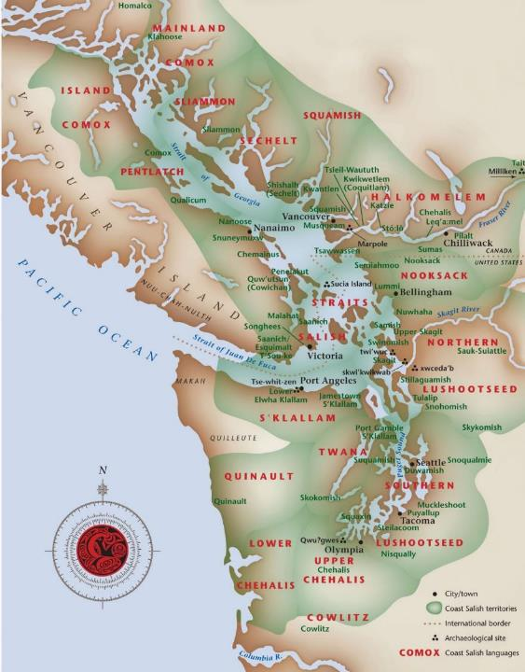
Coast Salish Peoples Map

Slide 4
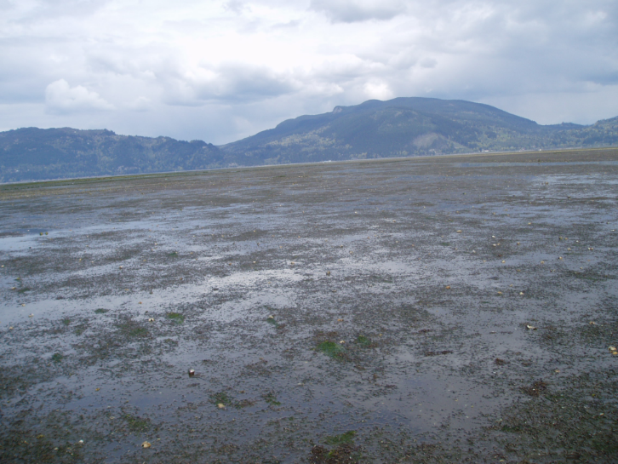
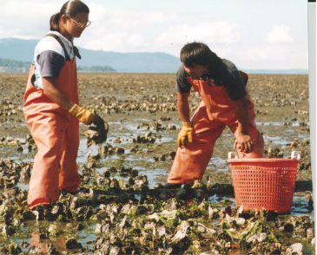
INTERTIDAL OYSTER CULTURE
Traditional on bottom culture
Typical intertidal oyster ground

Slide 5
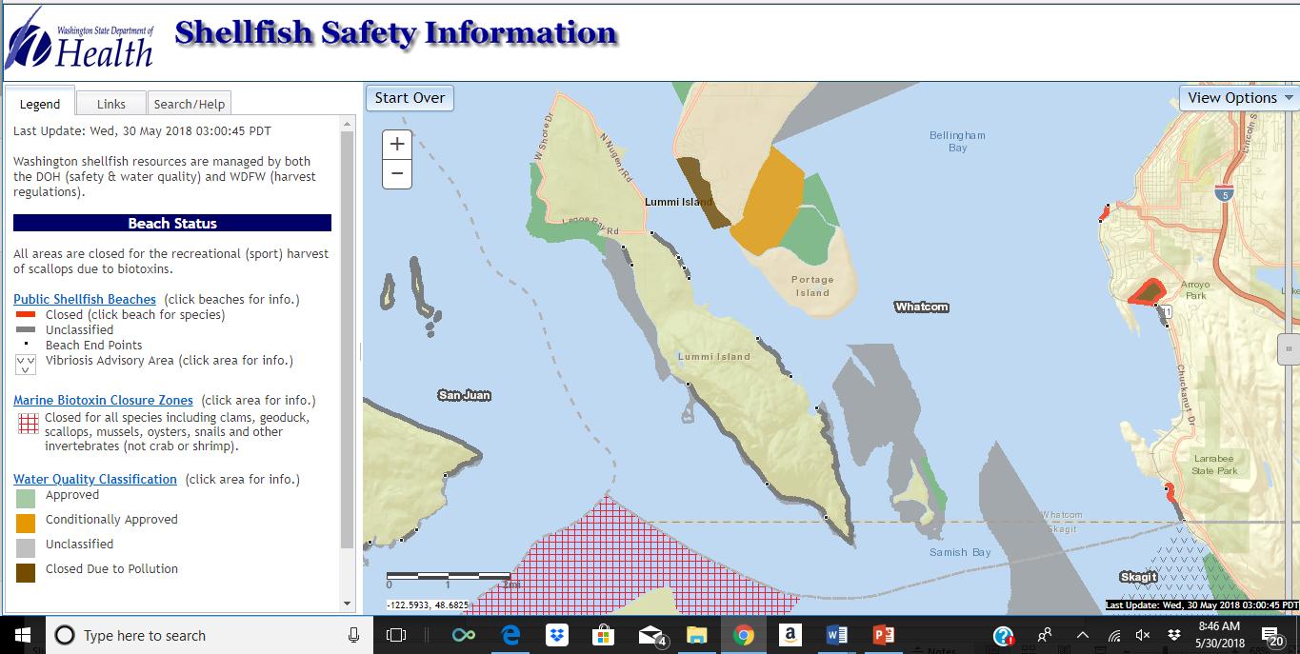

Slide 6
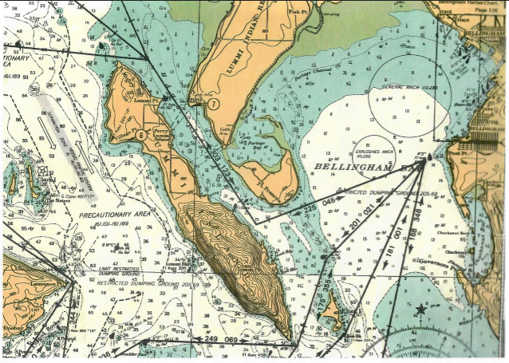
Topographic nautical chart

Slide 7
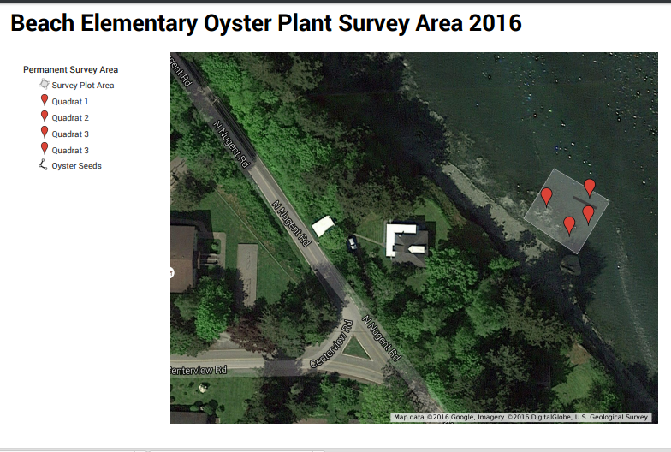
Mapping the Intertidal Zone:

Slide 9
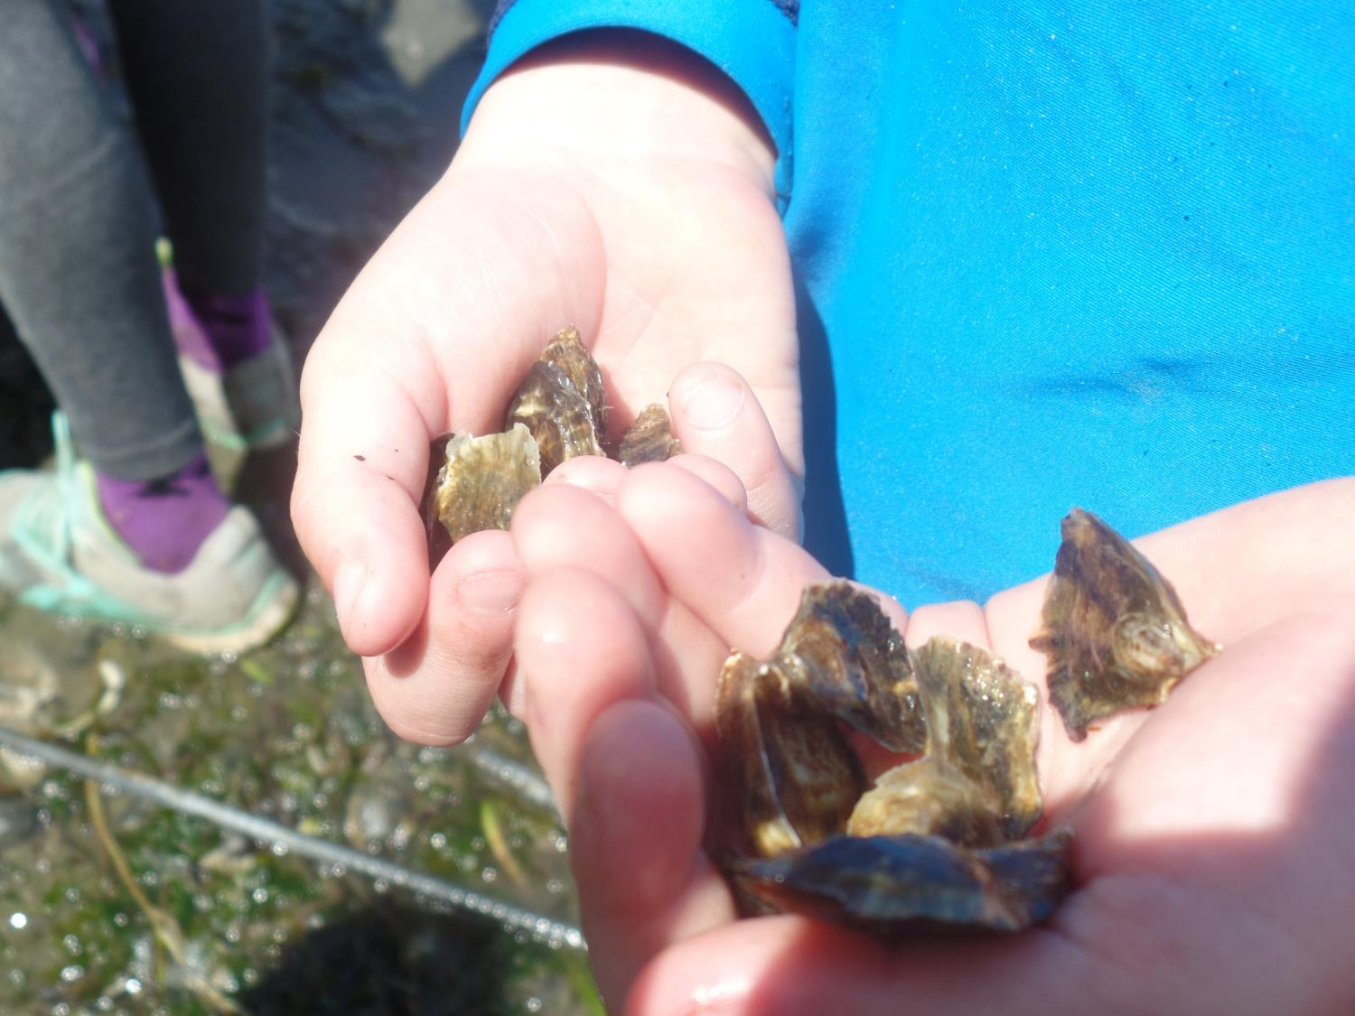
Average width = 2.4 centimeters (cm)
Average length = 2.5 centimeters
400 oyster seed planted at each site

Slide 10
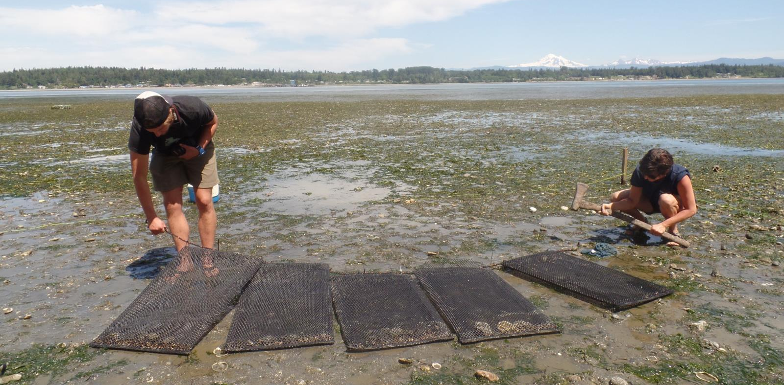
5 bags planted Paul’s Beach and 2 bags planted at 2850 N. Nugent (Judy Thomas’ house)

Slide 11
About 400 oyster seed planted at each of 2 sites.
If 1 adult oyster filters 50 gallons of seawater each day,
How many gallons will all of our oysters filter IF they all survived to adulthood?
Do the math:

Slide 12
We can map and monitor the intertidal zones

Slide 13
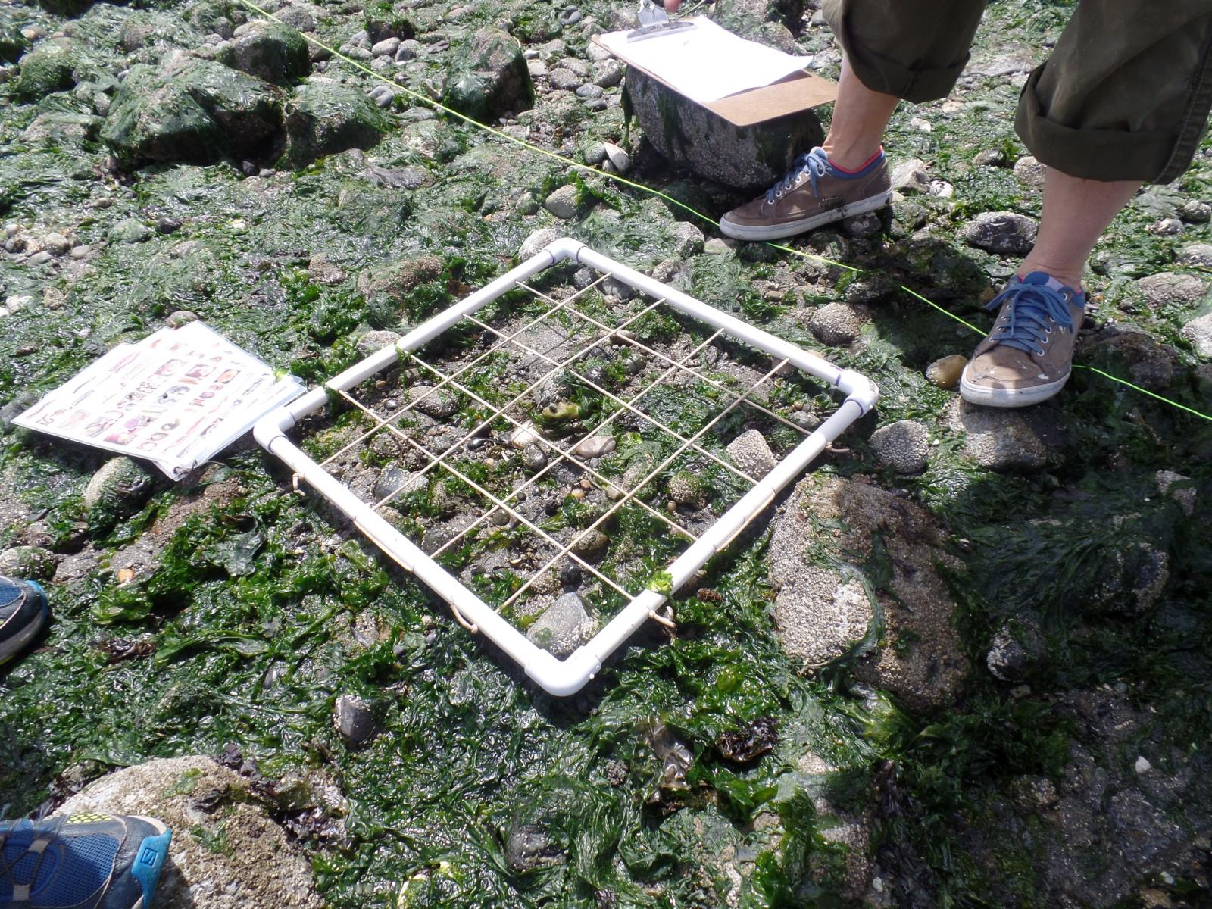

Slide 14
Beach Elementary Intertidal Survey Results
Substrate: mixture of rocky, cobble, muddy sand
Temperature: 76 F
Low Tide Time: 12:30 pm
GPS Coordinates for Survey Plot: 48°43.505 N; 122°41.122 W
Survey Size: 20 meters by 20 meters
Seaweeds
Most Abundant: Ulva spp. (Sea lettuce)
Other species present: Urospora sp.
Sea grasses
Most Abundant: Zostera Marina (Eelgrass)
Invertebrates (Sessile):
Most Abundant: Balanus glandula (Over 50% coverage in ¾ quadrats!) (Barnacles)
Invertebrates (Mobile)

Slide 15
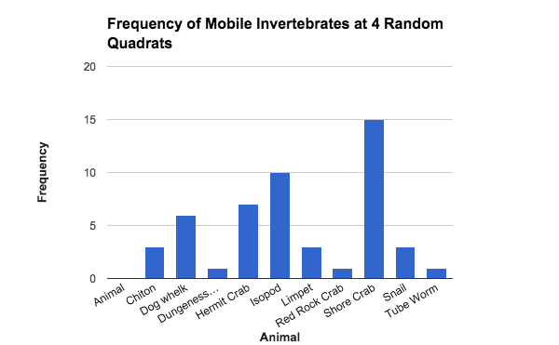

Slide 16
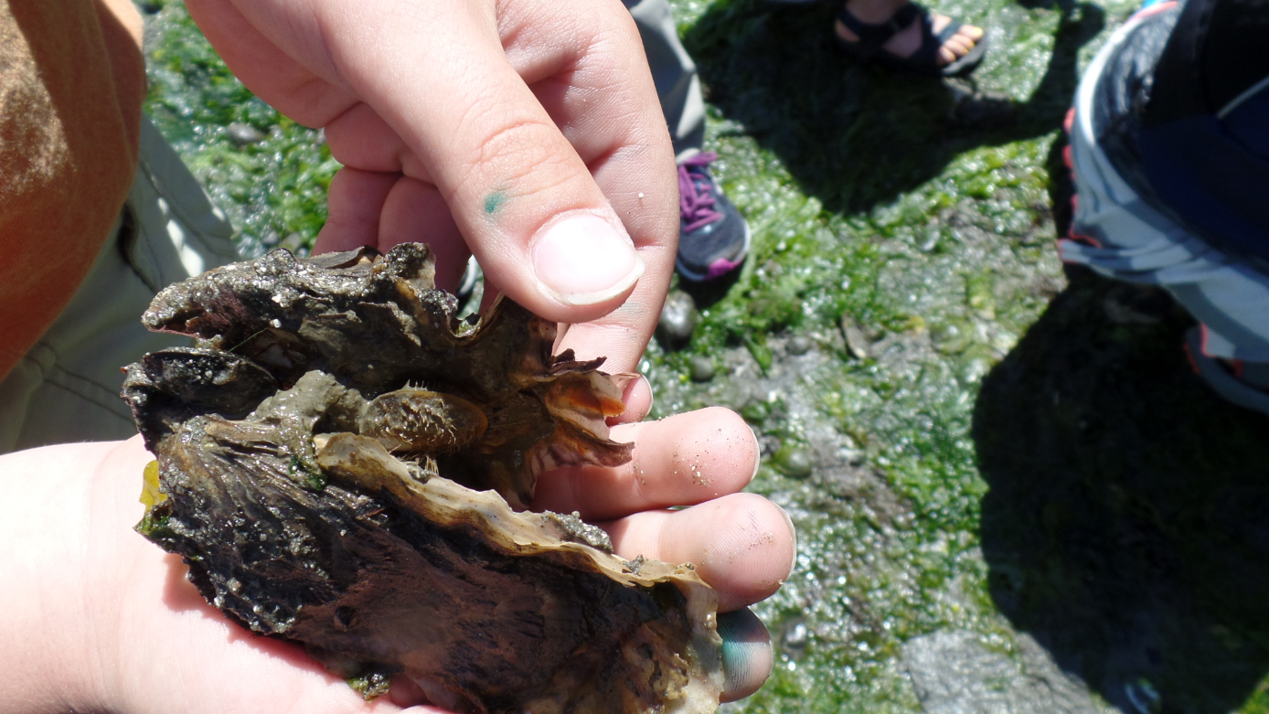
Observations: A muscle uses an oyster shell as it’s home – attaches with bissel threads.

Slide 17
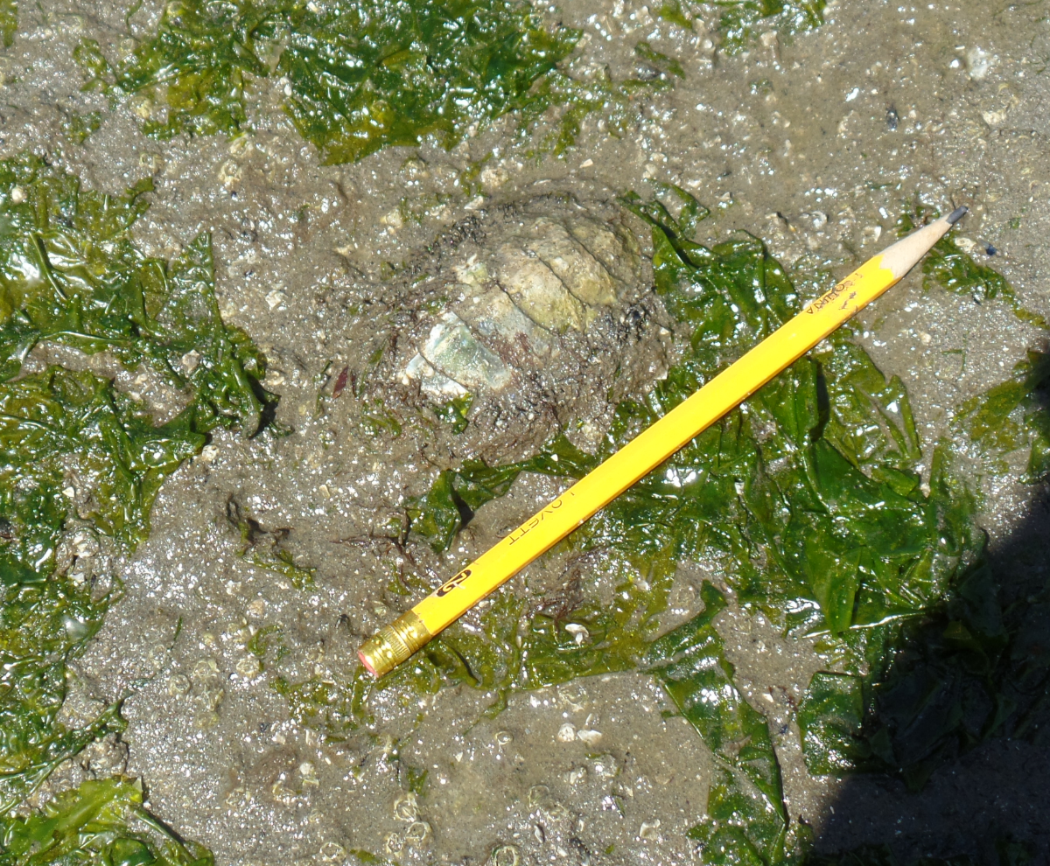

Slide 18
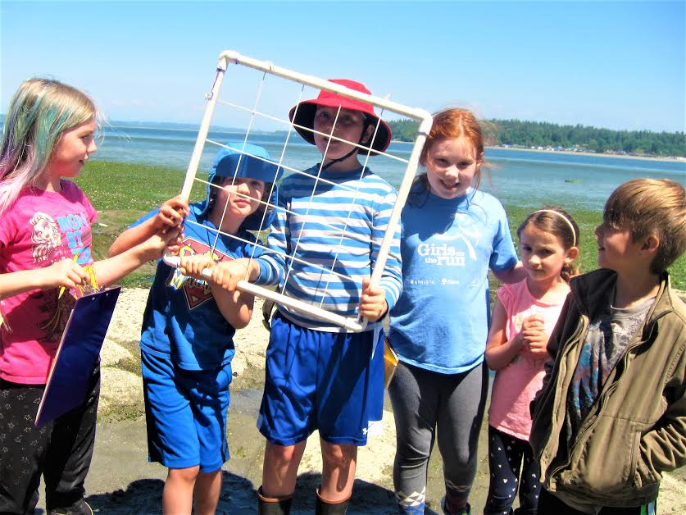

Slide 19
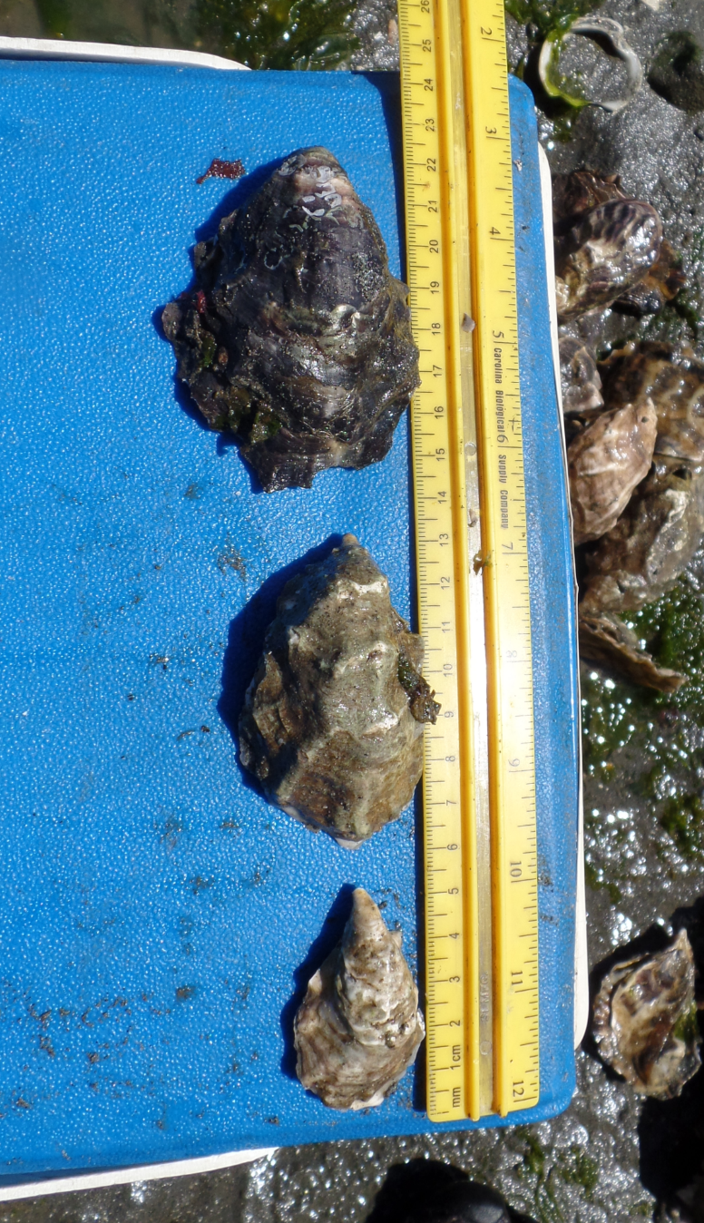
Conclusions:
Paul’s Beach:
In 1 year, oysters grew
3 cm width
4.2 cm length
Average width 5.2 cm
Average length 9.1 cm
Judy’s Beach:
In 1 year, oysters grew
4.4 cm width
3.9 cm length
Average width 3.41 cm
Average length 4.6 cm

Slide 20
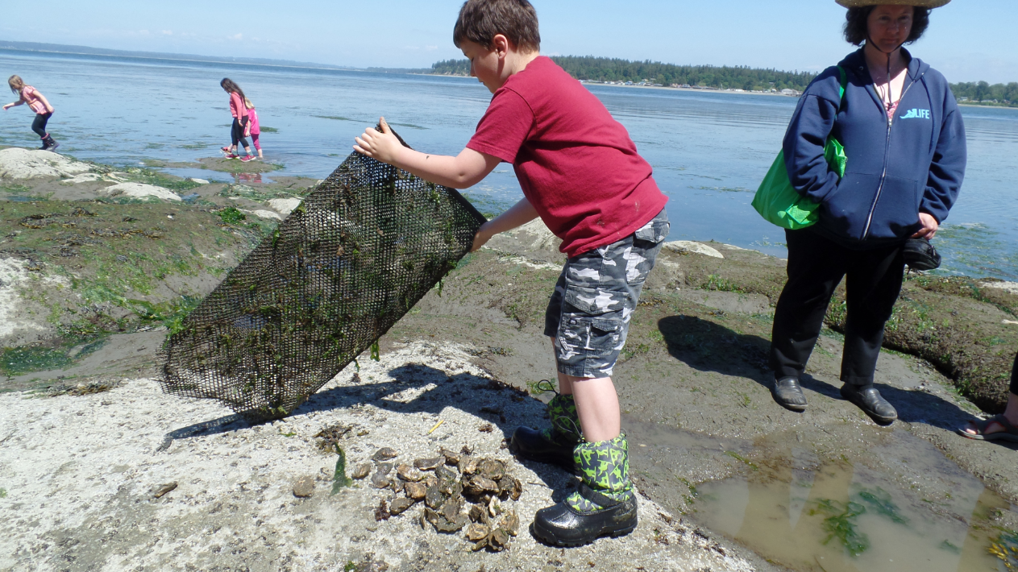

Slide 21
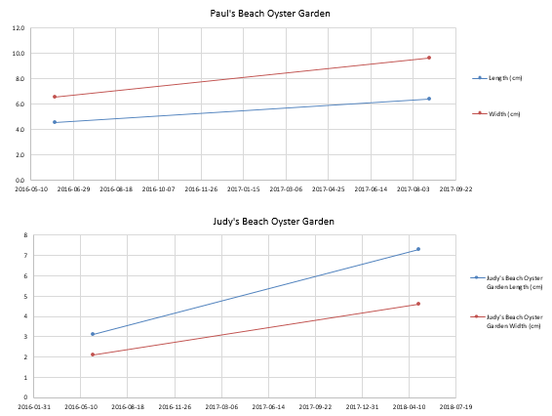

Slide 22
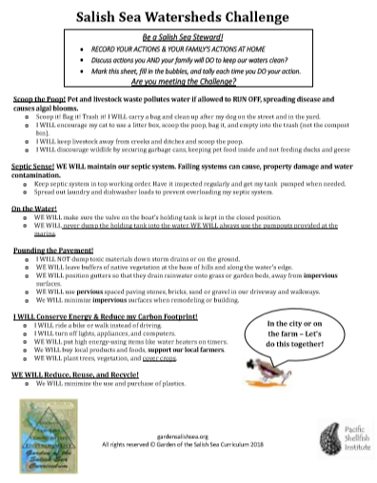
As stewards of the Salish Sea, we can keep this water healthy which will keep us healthy!

Slide 23
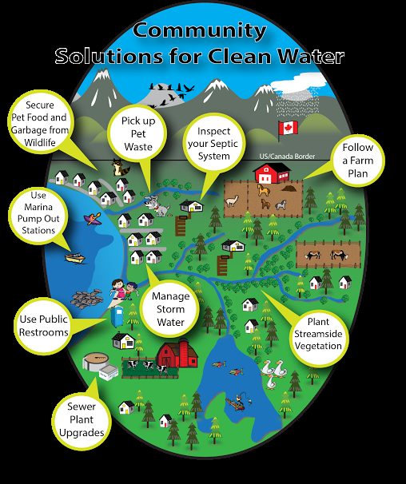

Slide 24
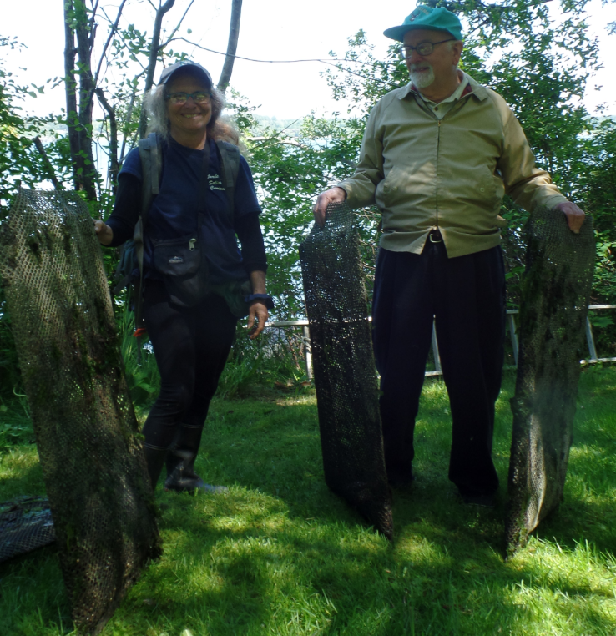
THANK YOU PAUL!

