Slide 1
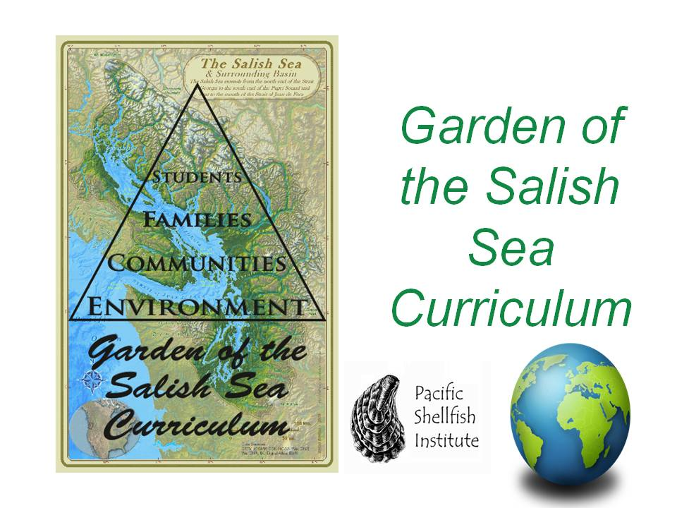
This product is funded through a Public Participation Grant from the Department of Ecology

Slide 2
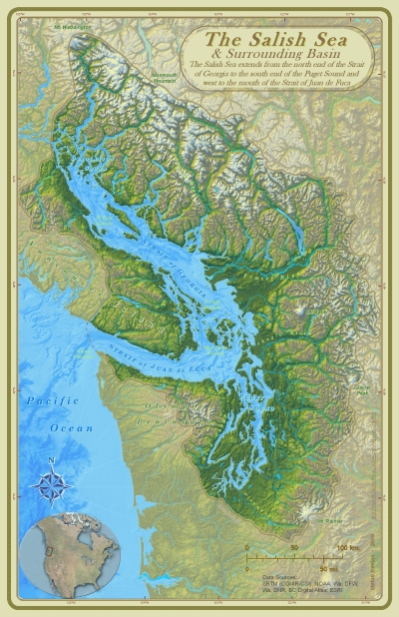
Land Acknowledgment
“When the tide is out, the table is set.”
Notes:
Land Acknowledgement: Let’s take a moment to recognize where we are. The Coast Salish Peoples have a saying "when the tide is out, the table is set.” The Coast Salish People rely on natural resources of the Salish Sea and have been stewards of this land and the traditional and customary fishing grounds for thousands of years and these resources continue to be used today.

Slide 3
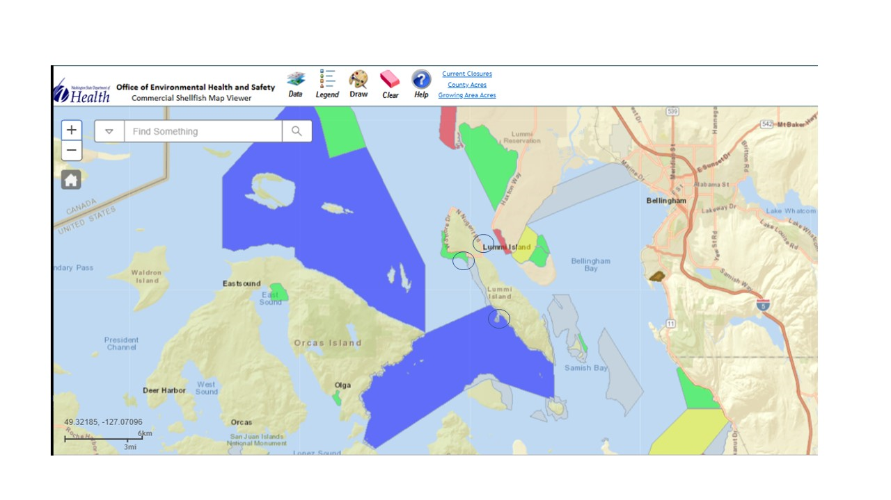
Sampling Location
3
2
1
Notes:
Today we will be studying the biodiversity of seaweeds in the Salish Sea. The algae samples we are looking at today were from 3 beaches on Lummi Island.
1 = Isle Aire Beach, exposed to the NW and Georgia Strait, gravel shoreline.
2 = Legoe Bay, faces S. on Rosario Strait, gravel shoreline
3 = Ferry Beach at Hales Pass, gravel shoreline.

Slide 4
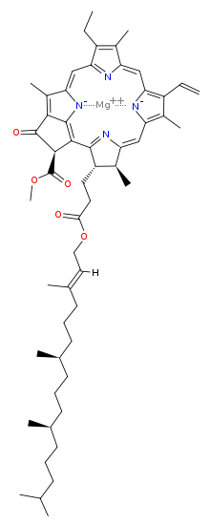
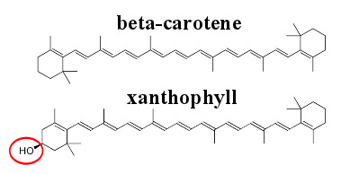
Pigment | Green | Brown | Red
Class | Chlorophyta | Phaeophyta | Rhodophyta
Accessory Pigment | None (Chlorophylls) | Carotenoids | Phycobilins
Accessory Pigment Molecule
Notes:
There are 3 main groups of algae which are defined by the differences in their pigments. These different pigments also make them adapted for different depths.

Slide 5
Notes:
Red and violet wavelengths do not penetrate the vertical water column very well so chlorophylls do not work well at greater depths. Algae that inhabit greater depths do so with the help of accessory pigments, these algae take on a variety of colors. Accessory pigments can harvest blue and green light − the wavelengths that chlorophyll can’t absorb well. They then transfer this light energy to chlorophyll molecules for use in photosynthesis. Brown algae, such as giant kelp and sargassum seaweed, contain a brownish accessory pigment and can live up to 115 feet deep. Red algae can thrive at greater depths. The light-absorbing ability of some red algae is so efficient that they can thrive at depths of more than 800 feet!

Slide 6
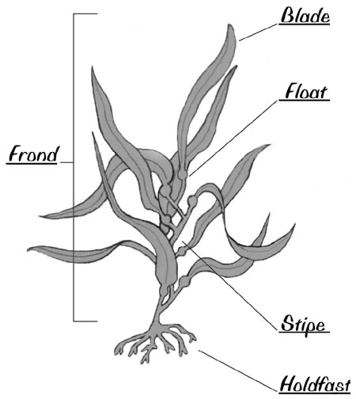
Algae Anatomy
Notes:
Since we are going to be trying to identify the different species in front of us I wanted to give a brief overview of the anatomy of algae.
Blade - leaf-like structure that use the sun's energy for photosynthesis
Stipe - stem-like structure
Float - air filled bladder at the base of each blade that keeps the plant up toward the surface as it gathers light for photosynthesis
Frond - the part which holds the plant to the ocean floor -- it is like a root, but does not supply water and nutrients to the rest of the plant.
Holdfast - Unlike a root, the kelp's holdfast doesn't supply water and nutrients to the rest of the plant. A holdfast keeps algae in place so currents and tides don't wash the organism away.
This is similar to the diagram we expect for you to do of the samples you identify.

Slide 7
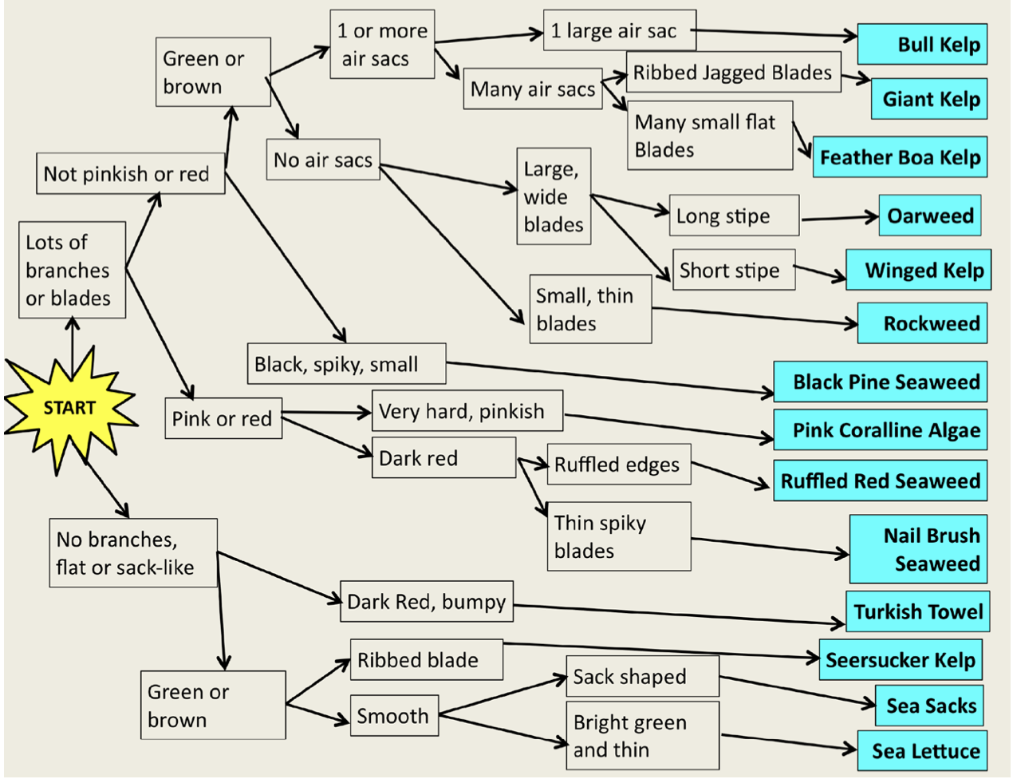
Notes:
This is the key that you will use to help you identify your algae. If you aren’t familiar with keys, they are somewhat like a choose your own adventure book. At each branch of the key you assess the algae in front of you for each of the characteristics until you find the species. Once you find the species you can use the reference books to find pictures to confirm your identifications. There are a variety of keys at your tables, and not all species are on each one so it is important to use the reference books to make sure your identification is correct.

Slide 8
Next Steps...
Take the next 30 minutes to identify and diagram at least 2 species on your table.
Diagrams need labelled features that you used to identify the species.
Table groups should report species to the list on the board.

Slide 9
Wrap Up
What adaptations did you notice?
How might the adaptation aid in survival in the intertidal zone?
What can you do to protect these species?
Notes:
(5 min) Ask students for some of the adaptations that they observed and how they may help the organism live in the intertidal zone.

Slide 10
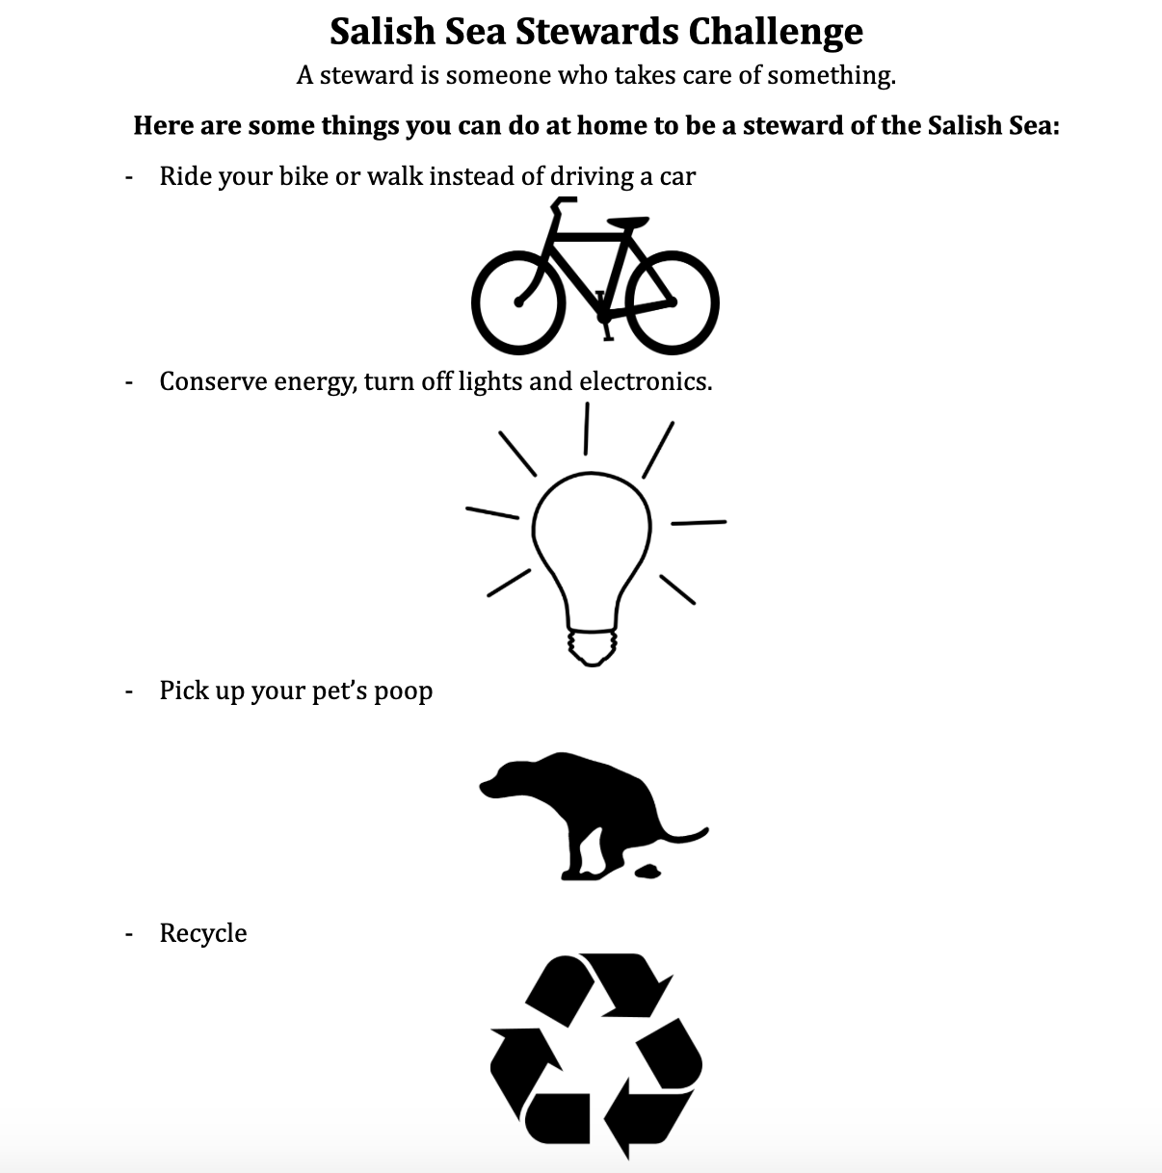
Notes:
(5 min) Discuss Salish Sea Challenge and actions they can take to help sustain biodiversity. Hand out Salish Sea Challenge.

