Slide 1
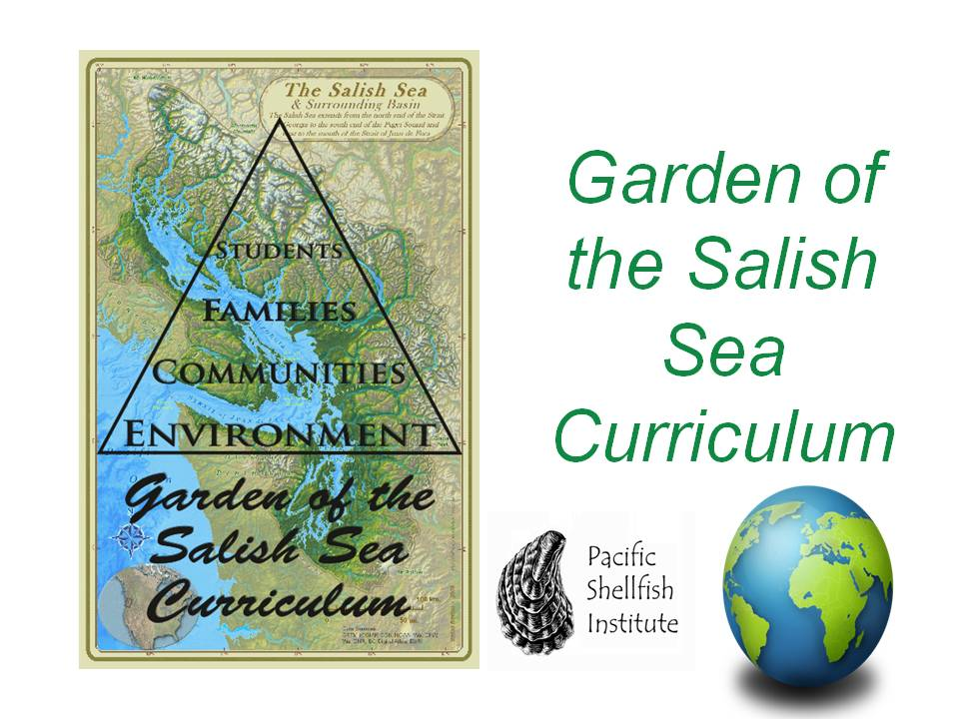
This product is funded through a Public Participation Grant from the Department of Ecology

Slide 2
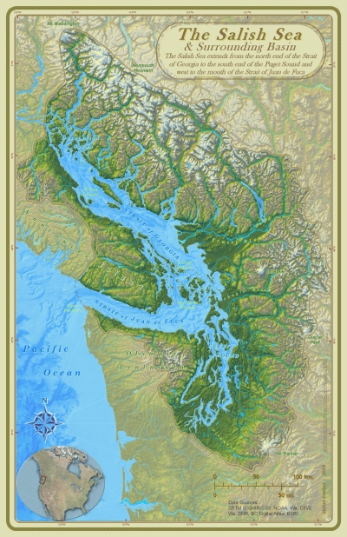
Land Acknowledgment
“When the tide is out, the table is set.”
Notes:
Land Acknowledgement: Let’s take a moment to recognize where we are. The Coast Salish Peoples have a saying "when the tide is out, the table is set.” The Coast Salish People rely on natural resources of the Salish Sea and have been stewards of this land and the traditional and customary fishing grounds for thousands of years and these resources continue to be used today.

Slide 3
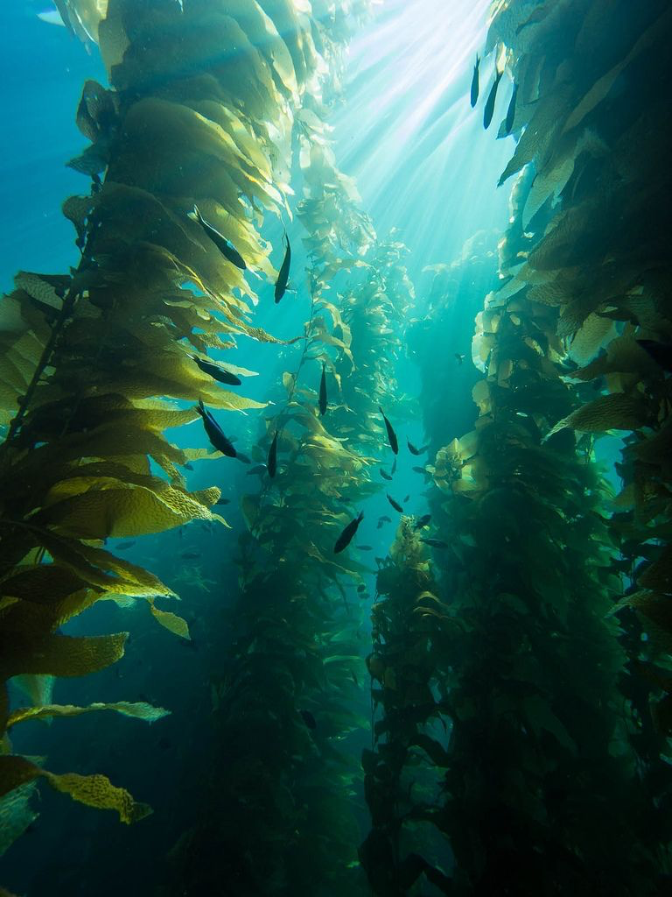
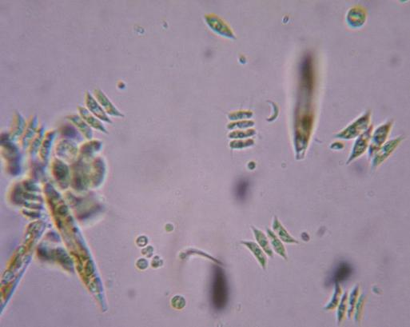
PNW Algal Diversity
Notes:
Algae in the PNW can range from microscopic organisms (phytoplankton) to large kelp forests.

Slide 4
Ecosystem Services
Produce oxygen
Primary producers
Provide Habitat
Carbon sequestration
Human Uses
Notes:
Produce oxygen: 70 - 80% of the worlds oxygen comes from algae!
Primary producers: They act as the bottom of the ocean food chain
Provide Habitat: Kelp forests are a great habitat
Carbon sequestration: As algae photosynthesize they take up carbon.
Human Uses – components of some fertilizers, carrageenan, a healthy ingredient in food, and a potential alternative energy source.

Slide 5
Take 5 minutes to observe the biodiversity of seaweeds on the desks.
What adaptations do you notice?
Does this seem like a healthy biodiversity?
Notes:
These samples were collected during the cool storm season with high wave action. We expect higher diversity during the spring months as temperatures warm.

Slide 6
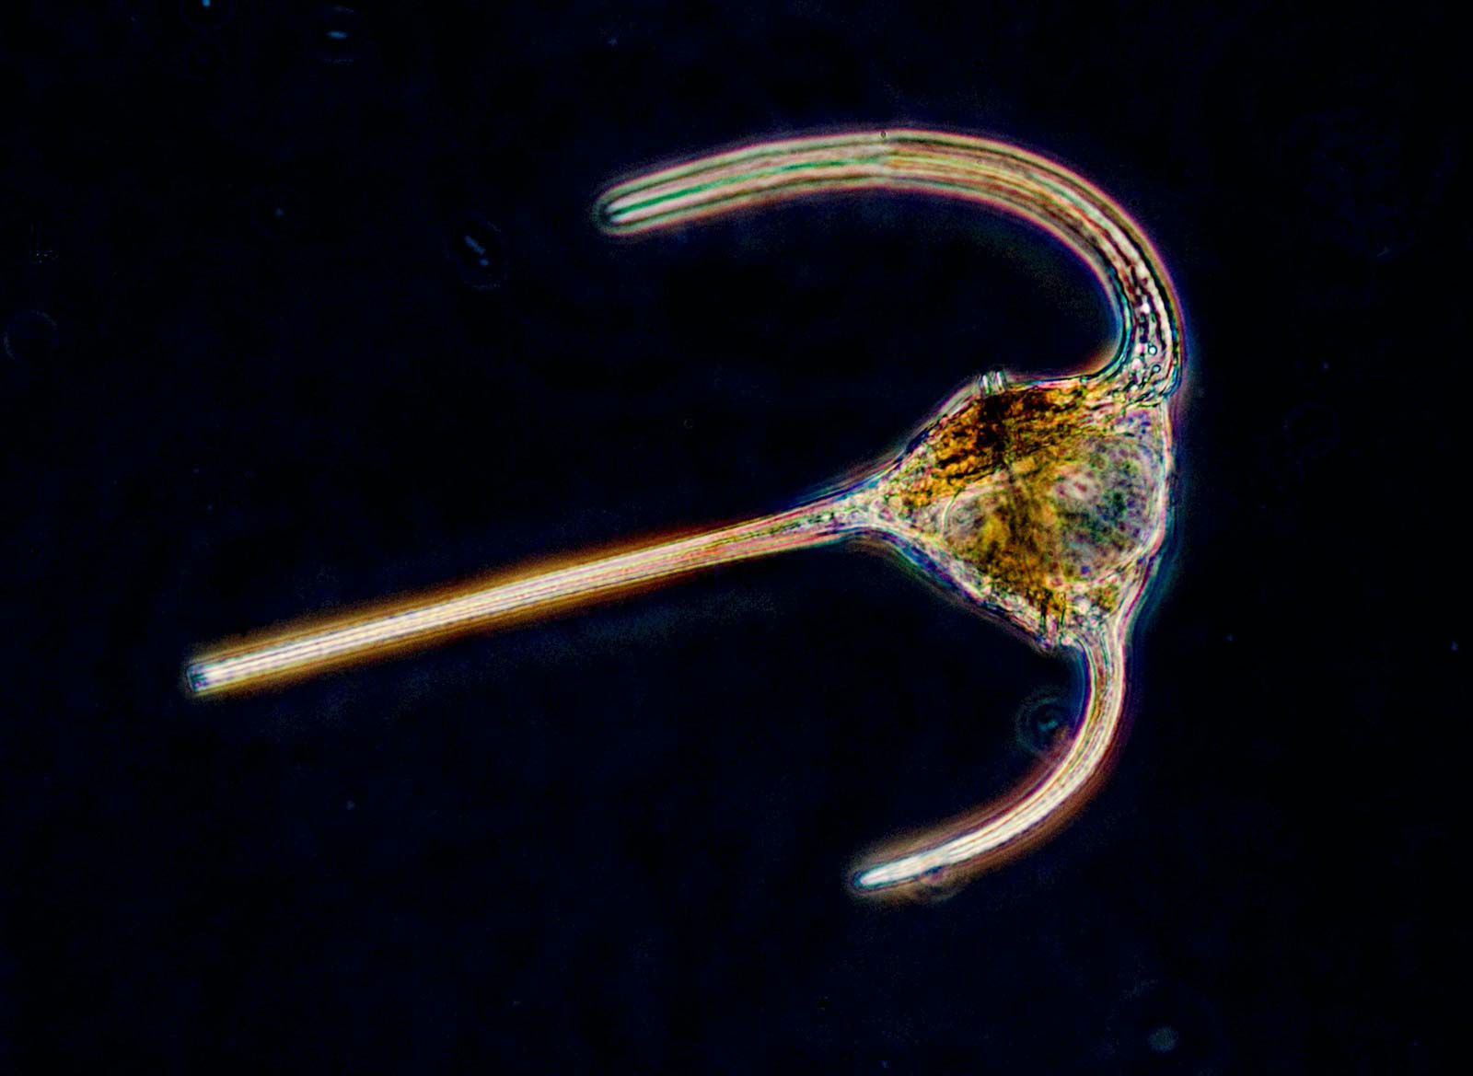
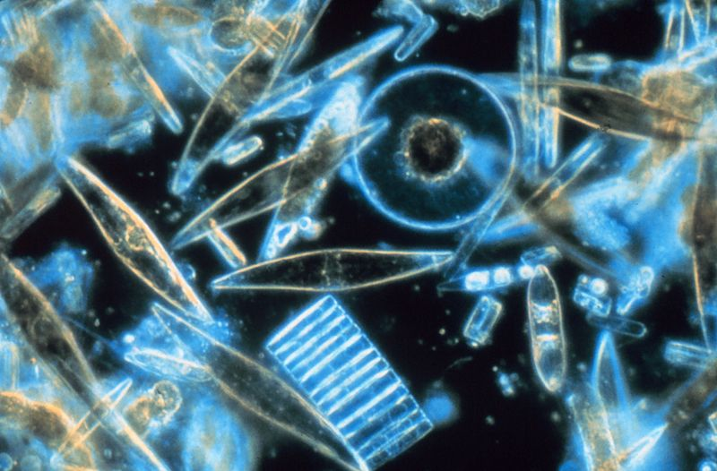
Phytoplankton
Notes:
Phytoplankton is the base of the food chain - take a moment to feed the live tank with a phytoplankton sample. Oysters, as filter feeders, eat the plankton out of the water and leave it cleaner than before.
Phytoplankton can be separated into two main categories, dinoflagellates and diatoms. Flagellates have whip like tails that allow them to have some control over their movement. This is normally limited to moving up and down in the water column. Diatoms are often silica based and can form long chains. Some of the flagellates can cause paralytic shellfish poisoning

Slide 7
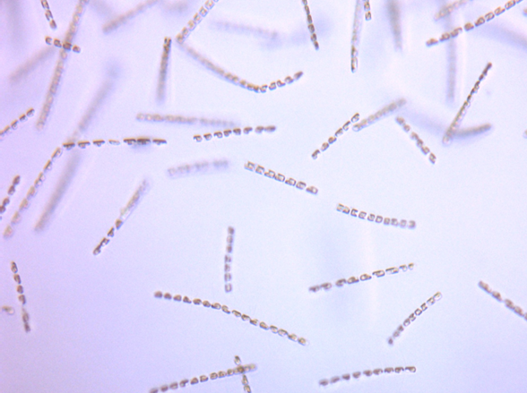
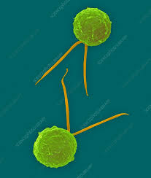
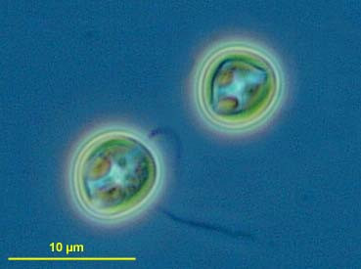
Next Steps...
Take the next 20 minutes to observe the algae in microscopes. Diagram and identify two samples in your science notebook. Remember to label structures & characteristics.
Chaetoceros mulleri (diatom)
Isochrysis lutea (flagellate)
Pavlova lutheri (flagellate)
Notes:
These are organisms in algal cultures provided by the Legoe Bay shellfish farm on Lummi Island. These are food that are grown to feed shellfish for seed in their geoduck hatchery for wholesale in the South Sound (Hood Canal).

Slide 8
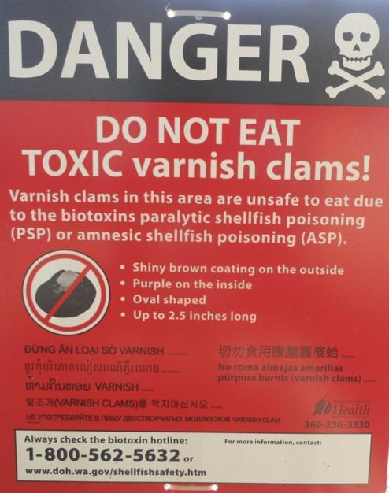
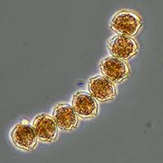
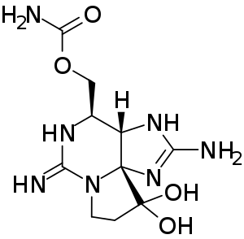
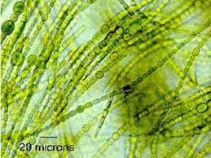
The saxitoxin molecule shown in its unionized state.
Paralytic shellfish poisoning caused by toxic algal blooms of blue-green algae (cyanobacteria) or dinoflagellates like Alexandrium sp
Notes:
Harmful algal blooms, such as those that cause Paralytic Shellfish Poisoning can have effects on biodiversity. Algal blooms can be caused by increasing temperature, lower dissolved oxygen (hypoxia), and increase in nutrients. PSP can affect fish, birds, and humans.

Slide 9
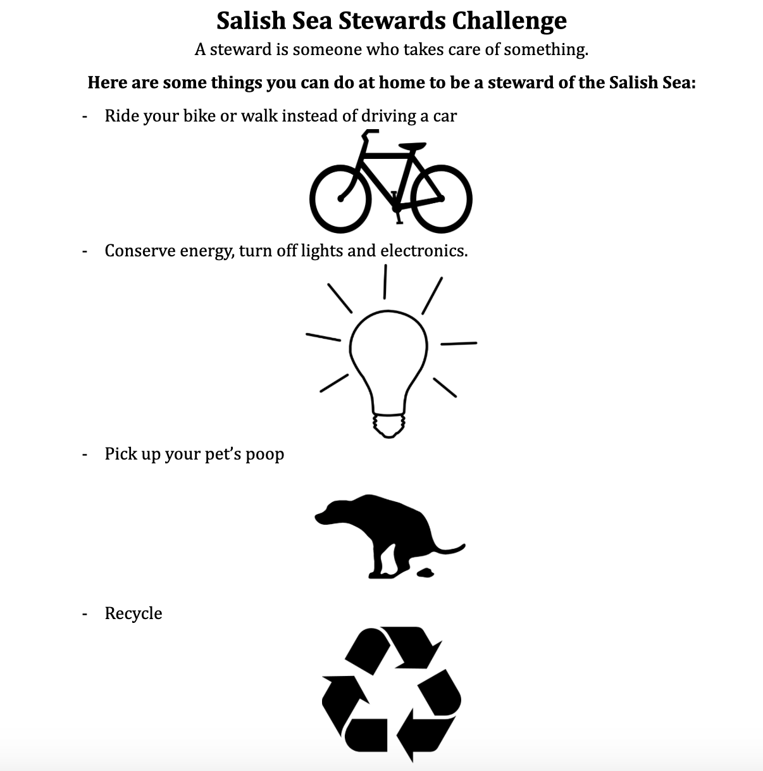
Notes:
(5 min) Discuss Salish Sea Challenge and actions they can take to help sustain biodiversity. Hand out Salish Sea Challenge.

